Slide 1
Song/Poem/Book
Allen Crawford's Interpretation of Walt Whitman's poem "Song of Myself”
Interpretation

Slide 2
Song/Book/Poem Interpretation
Choose a poem, book excerpt or song of interest and design a visual interpretation of what you think the words/lyrics are saying. You may incorporate part of the selected writing but you must do it creatively. Please include the title and author on the back of your sketchbook page. Be mindful of composition, concept and craftsmanship in your work.

Slide 3
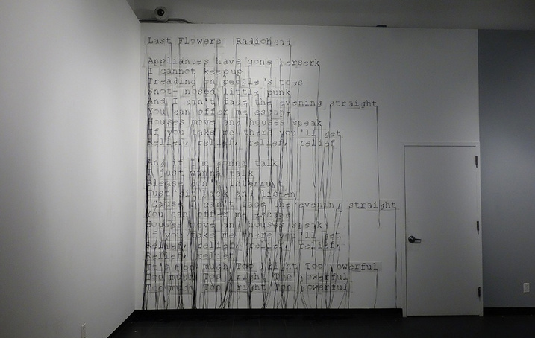
Song/Book/Poem Interpretation
Tips for Improving Your Grade…
"Last Flowers"- Radiohead
Concept is really going to shine in this assignment. Choose your subject wisely and really dissect what it is about
Don’t be afraid to create an abstract design. There are many artist who listen to classical or jazz music and represent the kinesthetic energy that comes with it (think Jackson Pollock’s drip paintings)

Slide 4
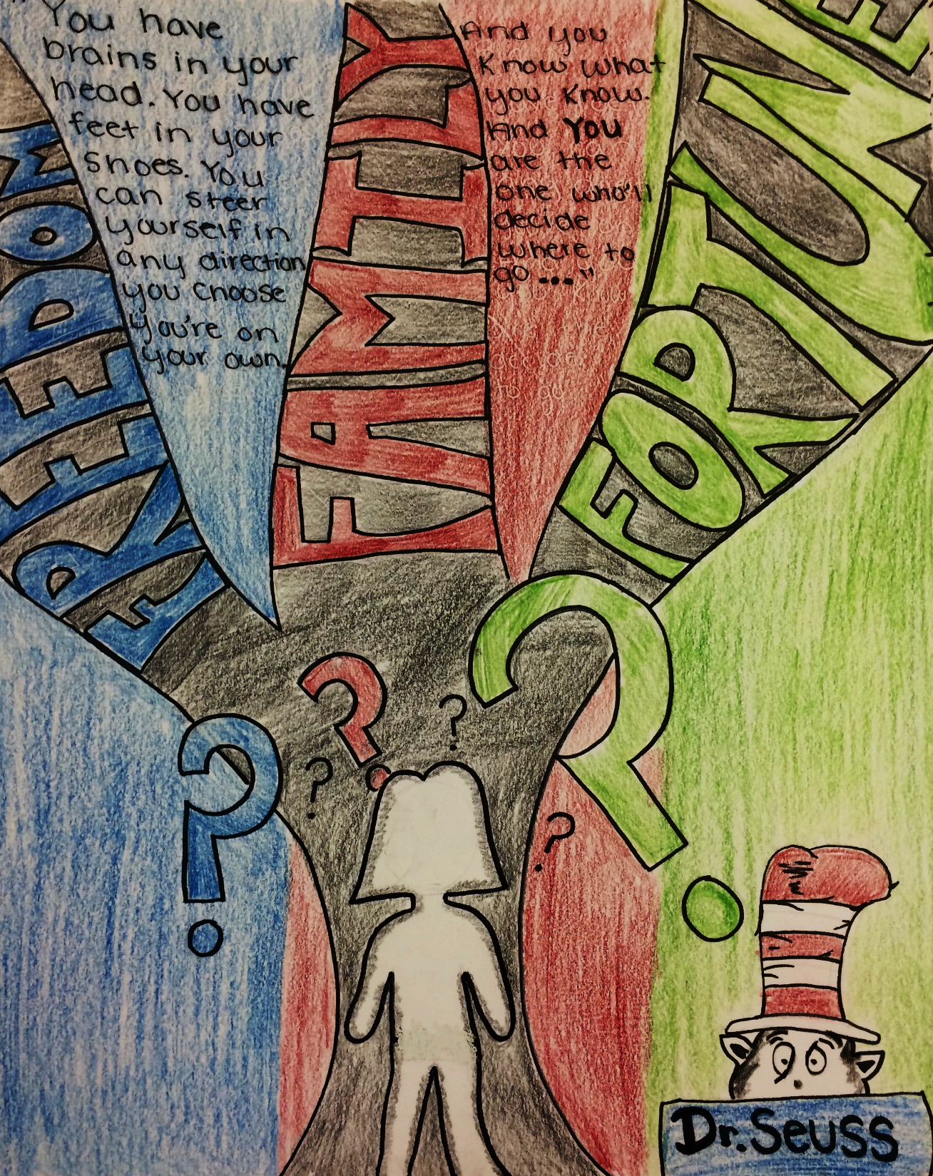
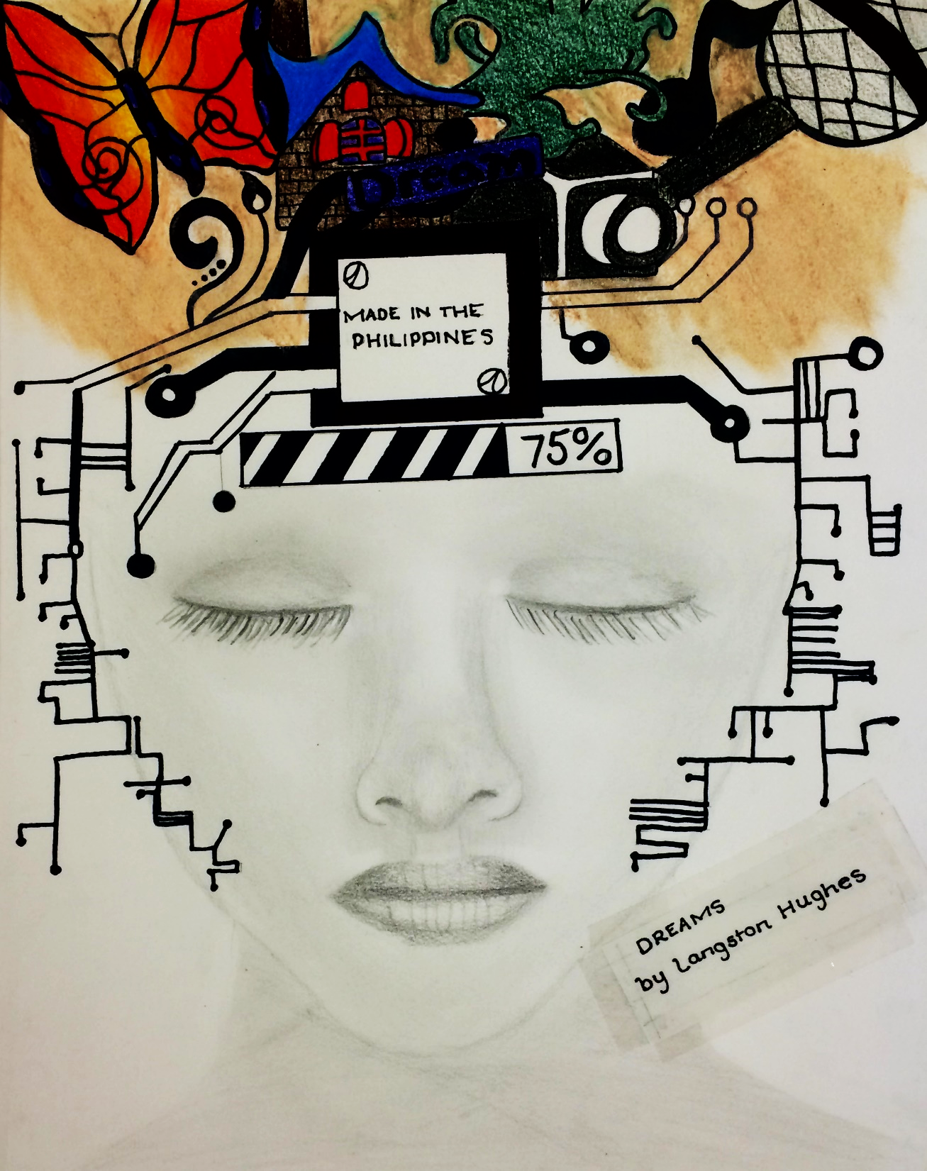
Student Examples

