Slide 1
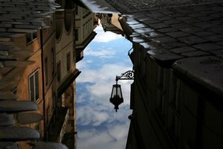
“Reflection”

Slide 2
“Reflection”
Create a drawing that symbolizes the word reflection. This drawing can be more literal as in an object reflected off a surface or it can be more conceptual like the perception of ones self or an assessment of an experience. Be detailed, think outside the box and be prepared for the next homework discussion.

Slide 3
“Reflection”
How one perceives themselves
Result of light and cast shadows
Mirror
Double image
Water
Glass

Slide 5
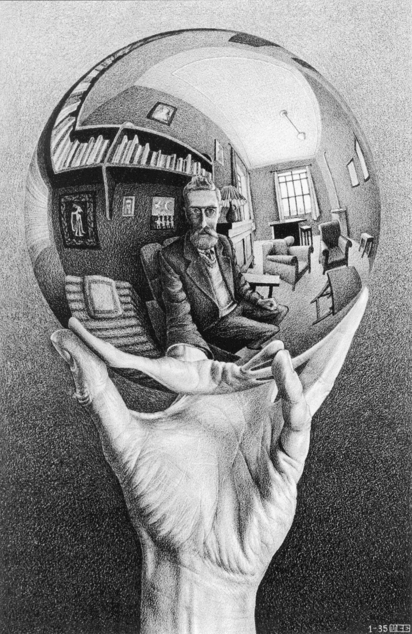
M.C. Escher

Slide 6
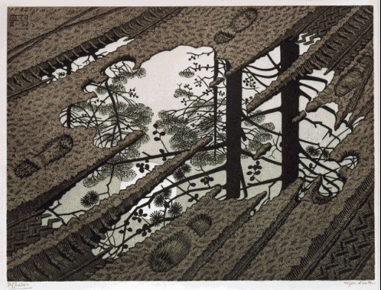

Slide 7
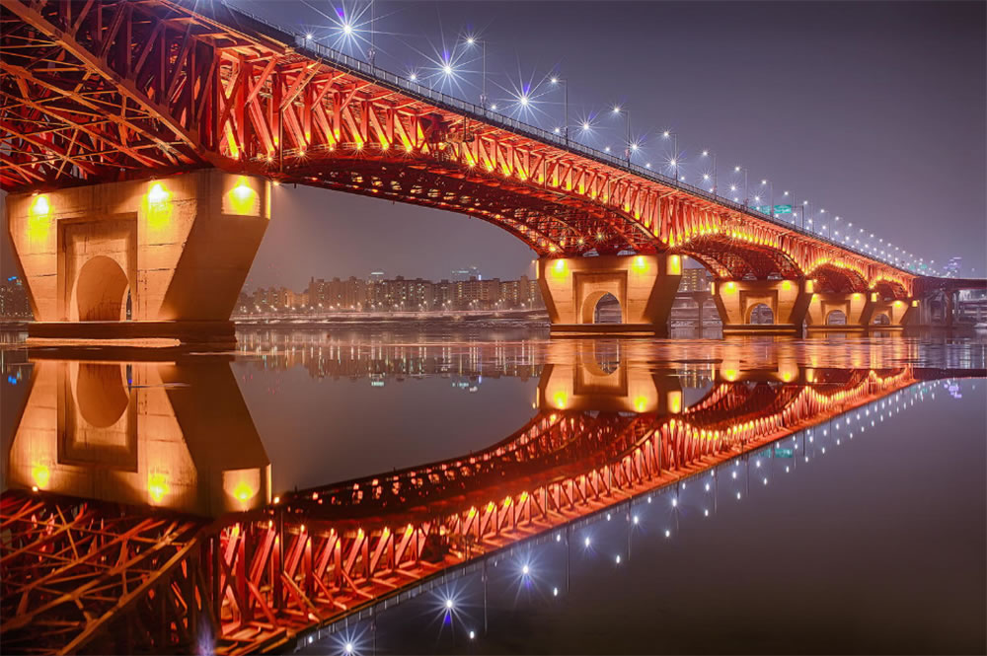

Slide 8
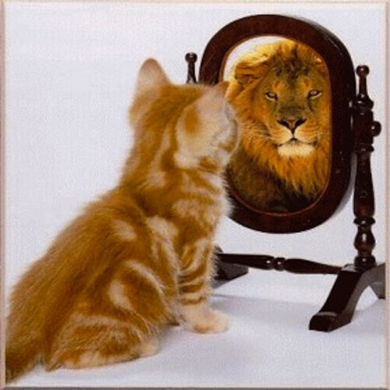

Slide 9
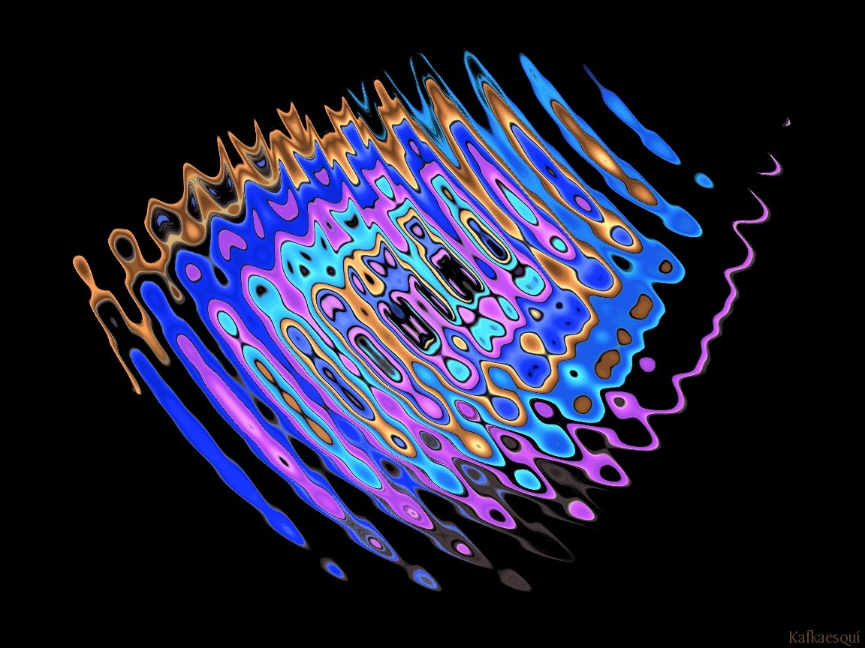

Slide 10
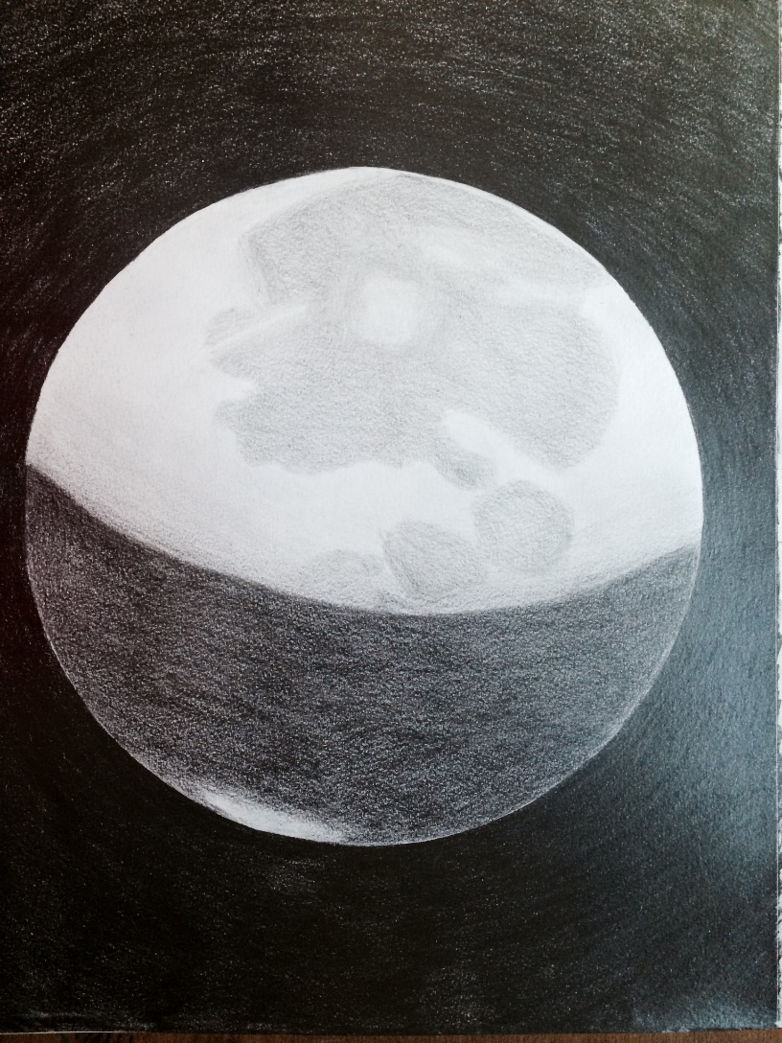
Student Examples

