Slide 1
Personification of your Chair

Slide 6
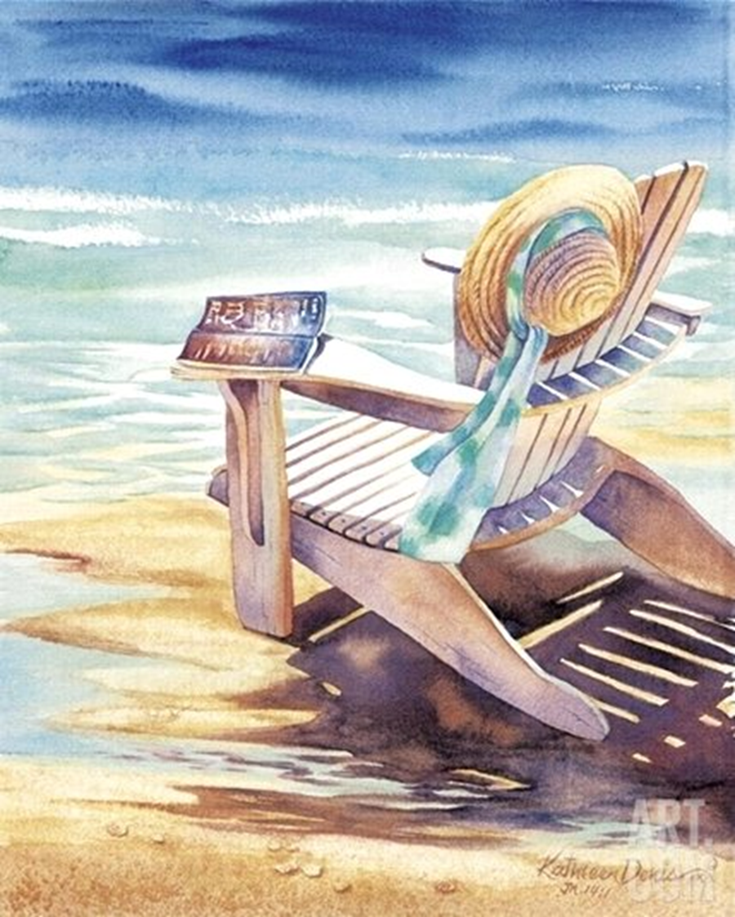

Slide 7
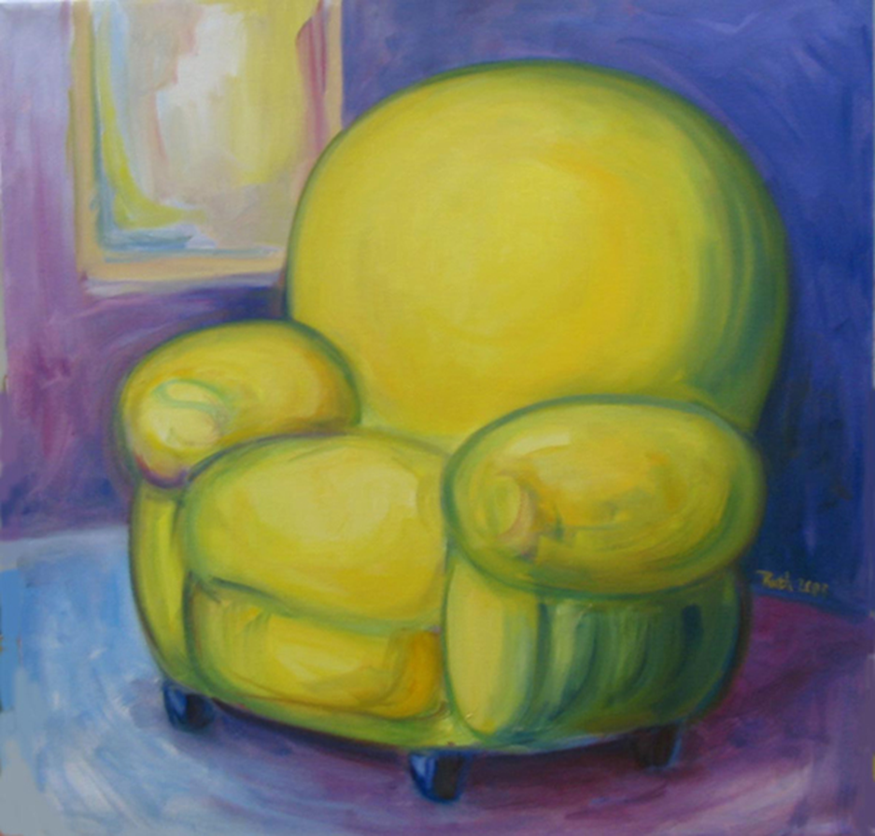

Slide 8
