Slide 1
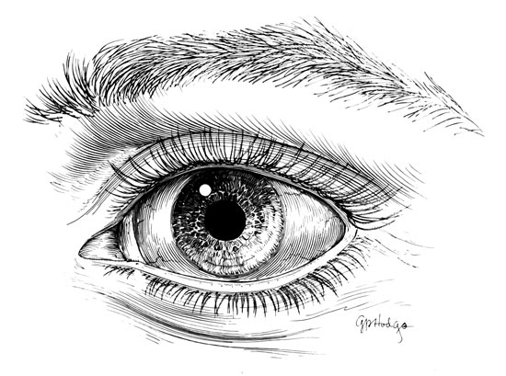
Line to Form
Studio in Art

Slide 2
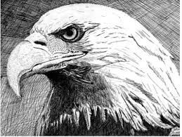
Line to Form
Click on the picture and view the pen and ink techniques demonstrated in both videos before starting the assignment
You must use your permanent markers to complete this homework assignment
Use what you just learned to create an image using only line to show value and texture. People, animals and nature are all great subjects for this assignment

Slide 3
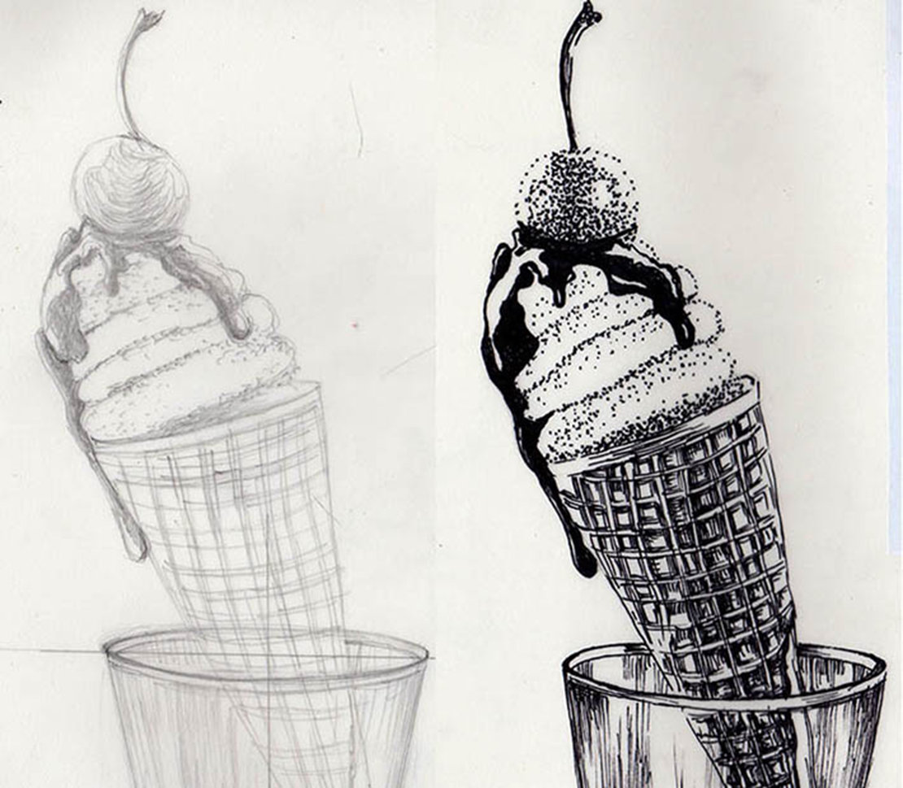
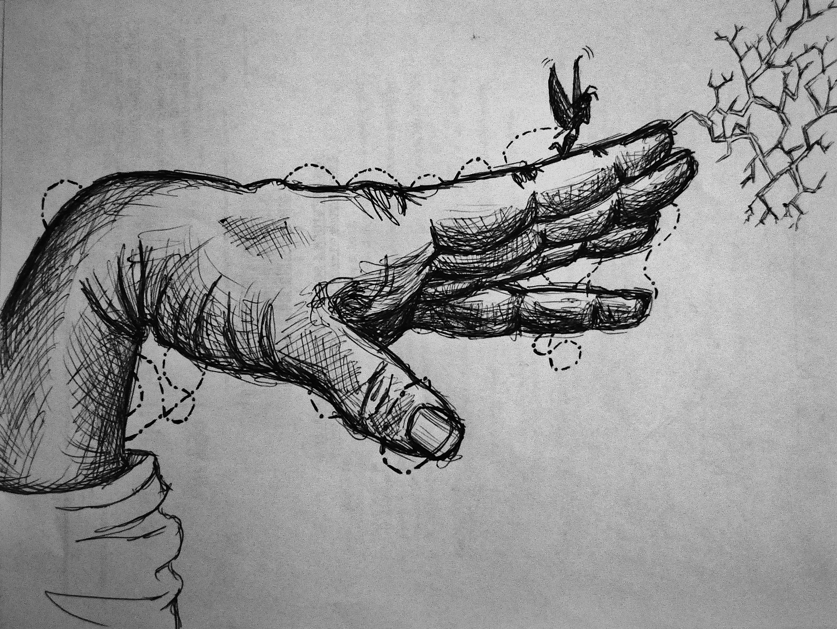
Line to Form

Slide 4
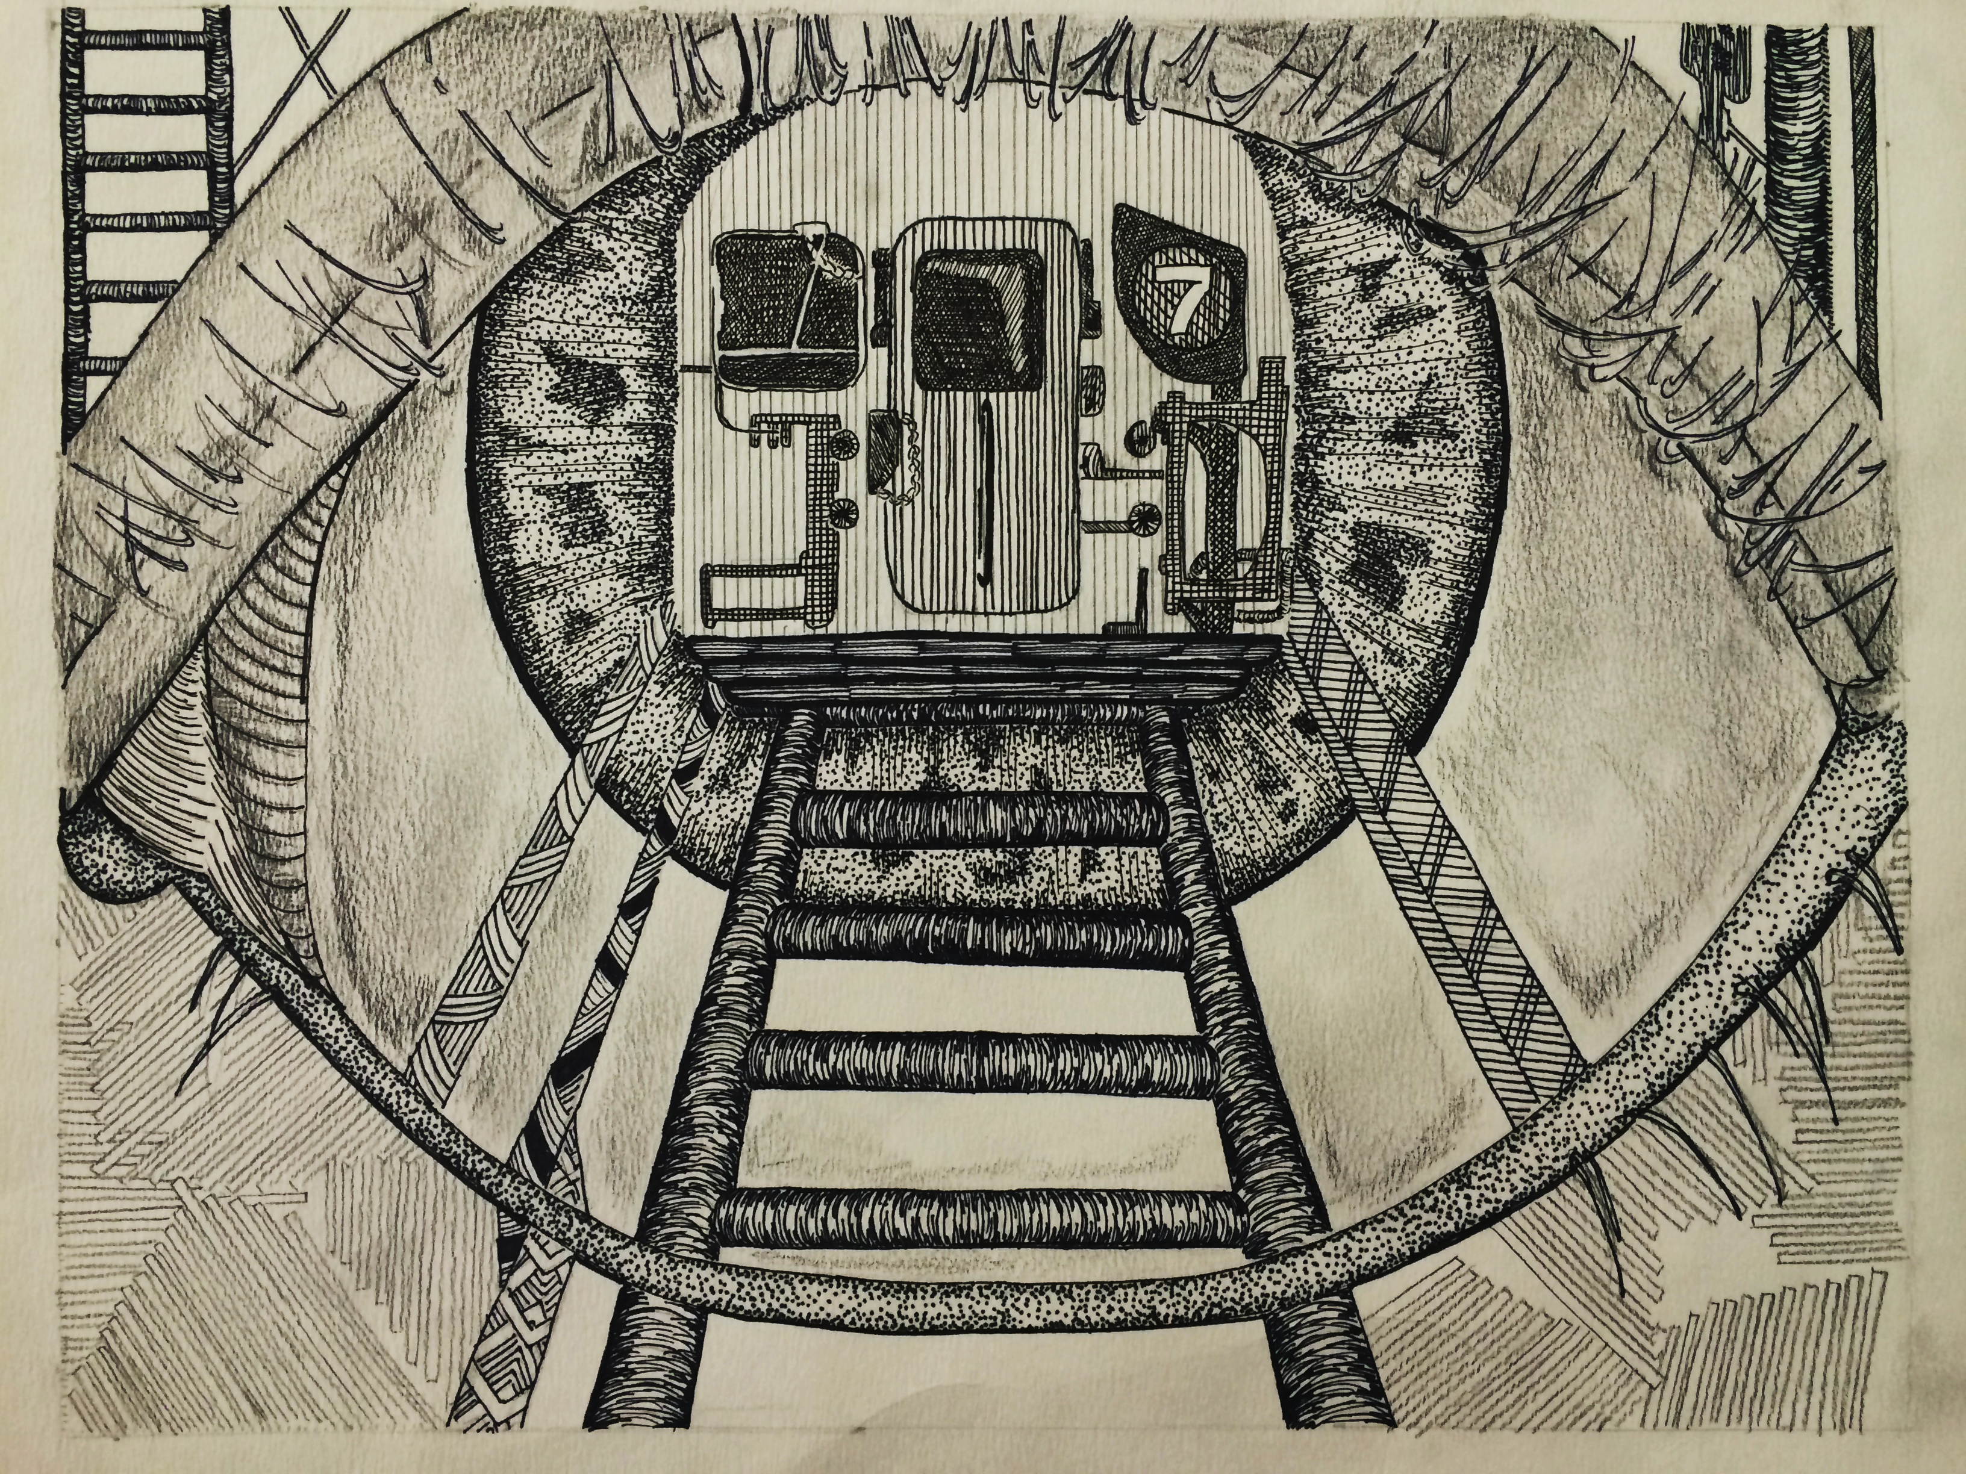
Line to Form
Tips and Tricks
Establish a clear light source in
order to build proper value
Develop your value only using repeated, layered lines/strokes
Be patient… make sure to repeat and separate your pen strokes. You don’t want starting coloring
Show a nice visual balance with contrast (even distribution of black and white) throughout your composition
Student Work- Honora Campbell

