Slide 1
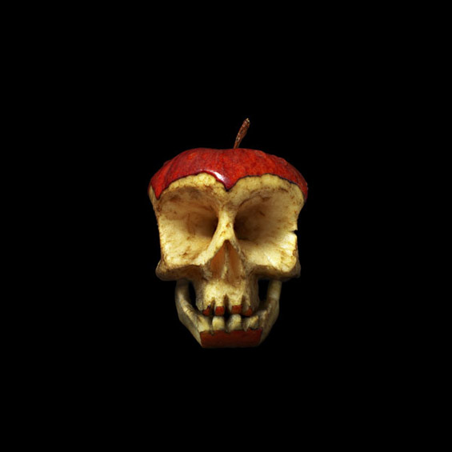
“Creepy”
Draw/Paint 1/2

Slide 2
“Creepy”
In the spirit of Halloween, this homework should reflect ideas behind the word creepy. Think about phobias and different types of fears. Consider animals and insects. Try to skew, warp or distort more literal objects to really emphasize the theme of creepy. This is a very open-ended assignment that you could use any media to create.

Slide 3
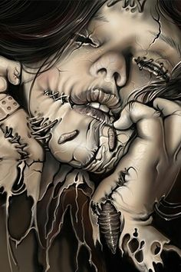
“Creepy”

Slide 4
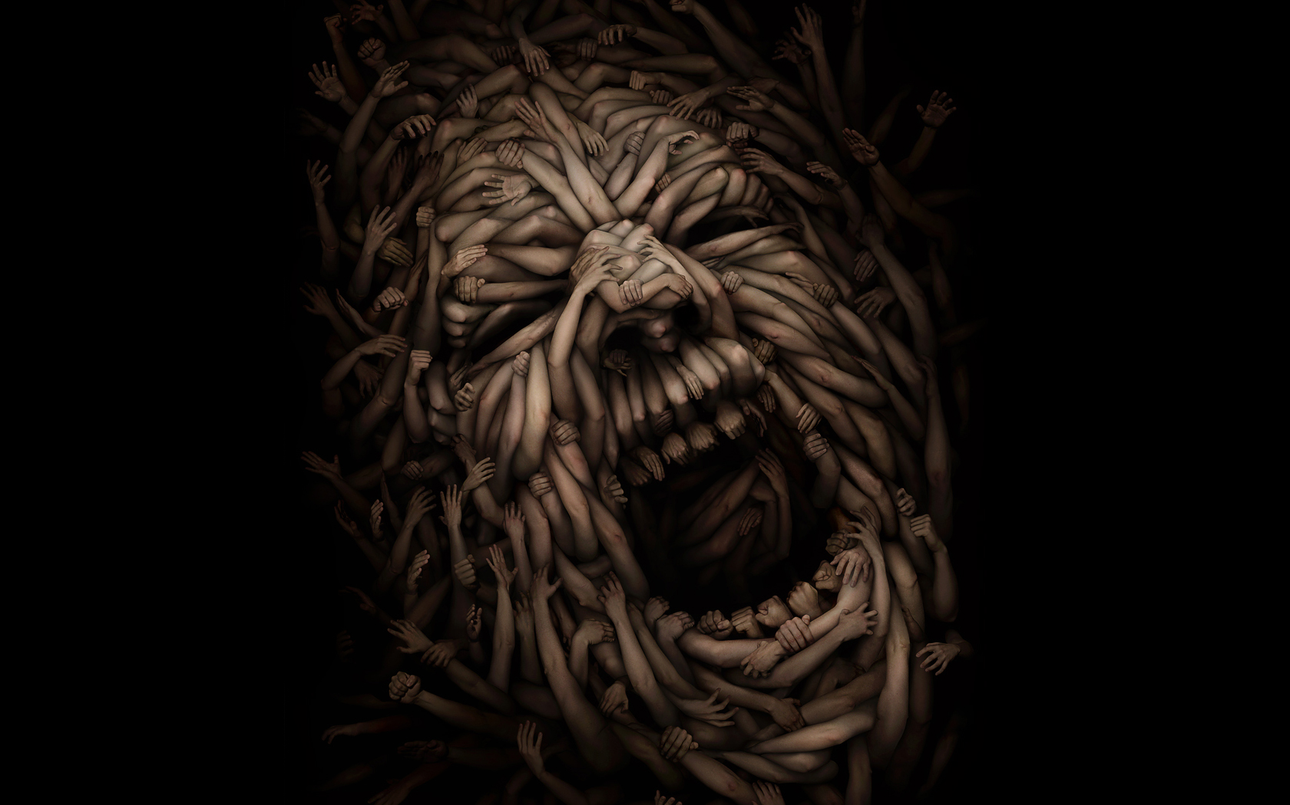
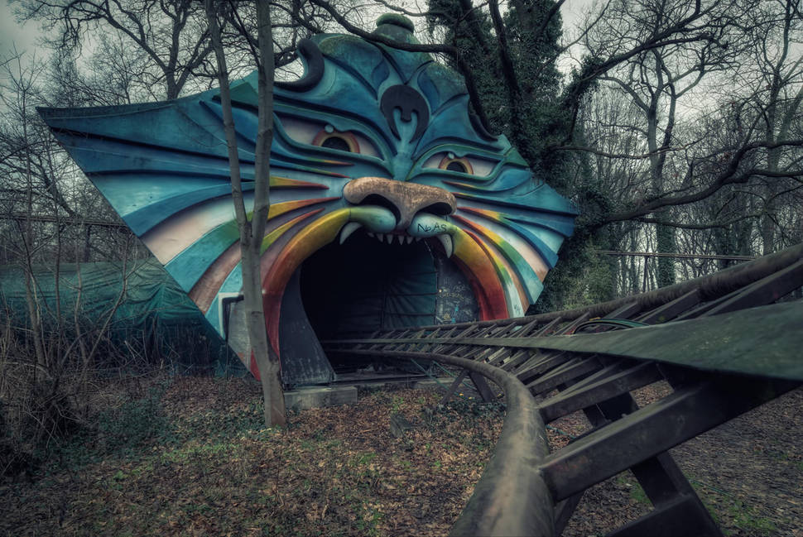
“Creepy”

Slide 5
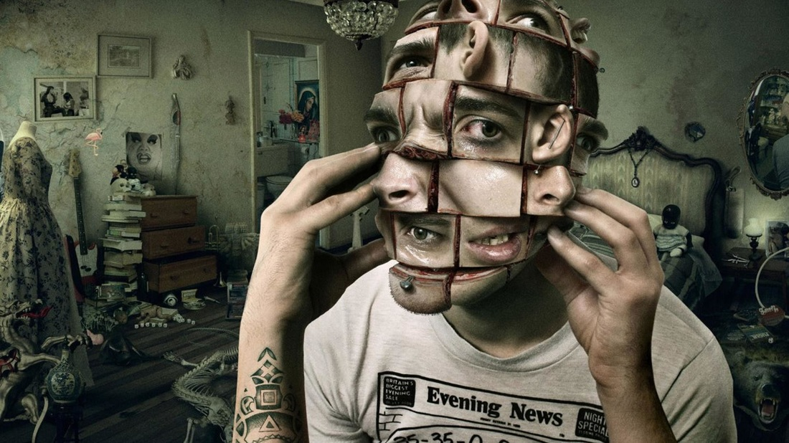
“Creepy”
Be creative and think outside the box!

Slide 6
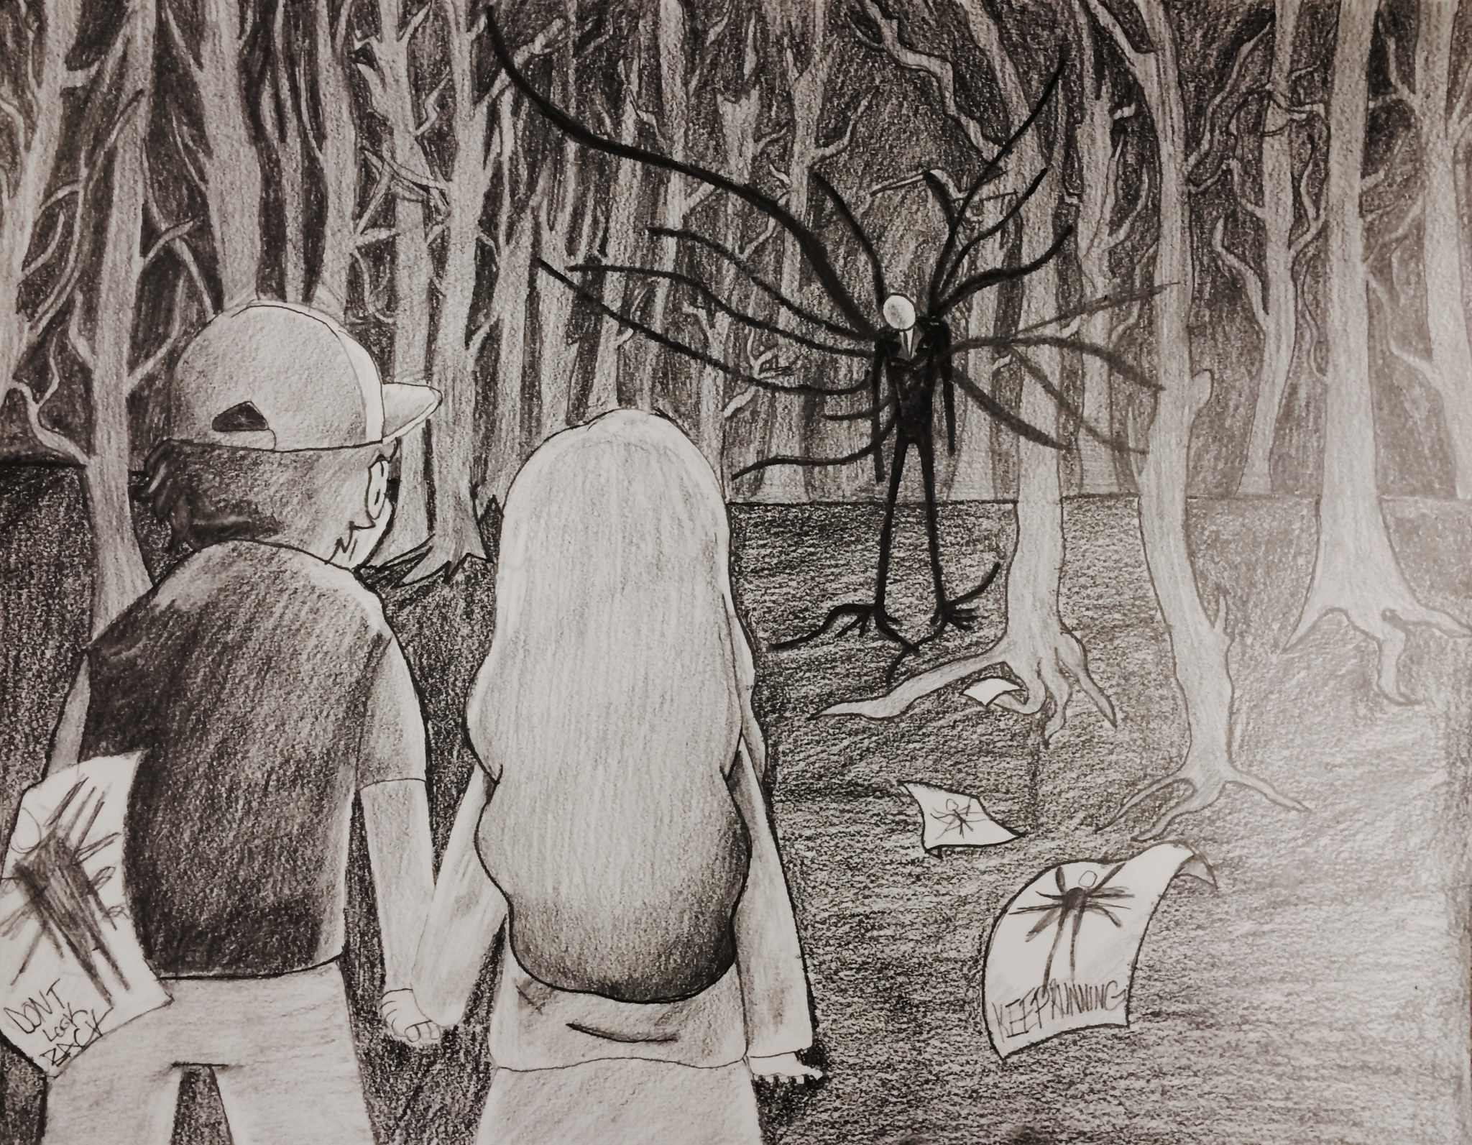
“Creepy”
Student Example
Iyanna Hood

