Slide 1
Biomechanical Art

Slide 2
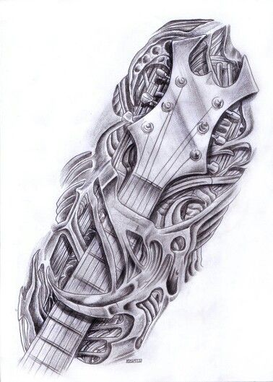
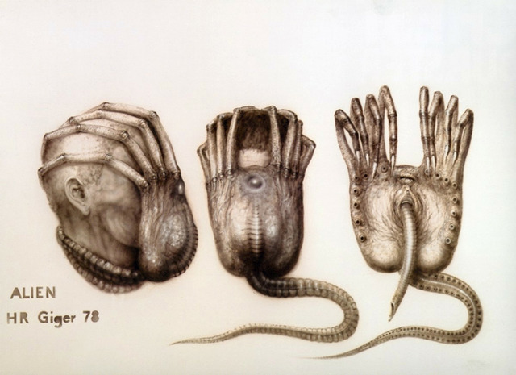
Biomechanical- study of the biological systems by means of the methods of mechanics.
Biology- study of living things (i.e. humans, animals, plants, organs, and cells
Mechanical principles- inanimate objects that are artificial/man-made (i.e. buildings, tools, structures, devices, inanimate objects)

Slide 3
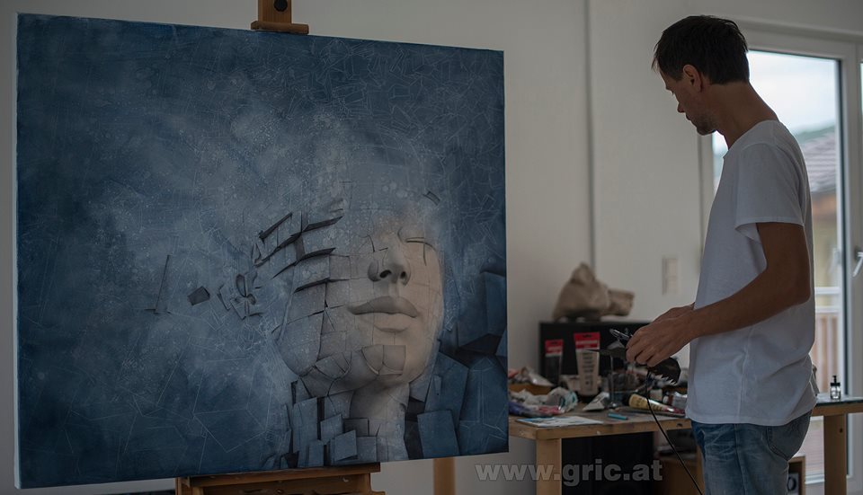
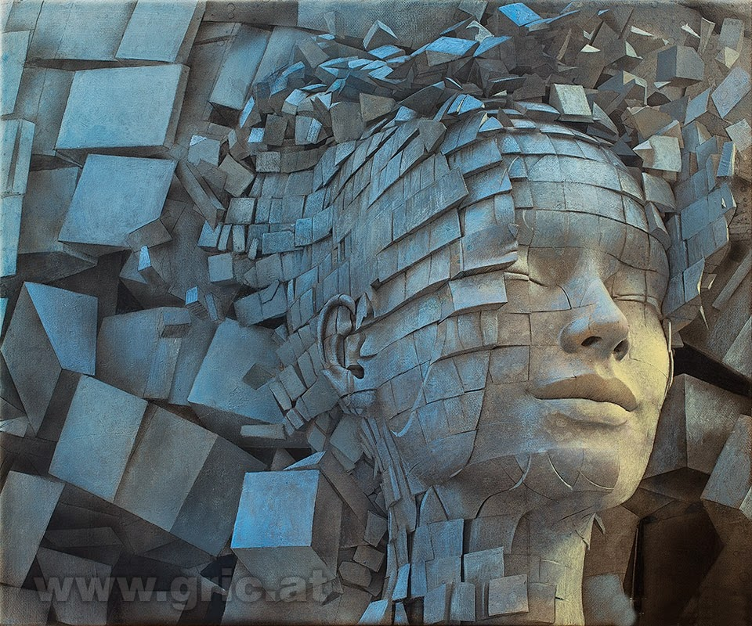
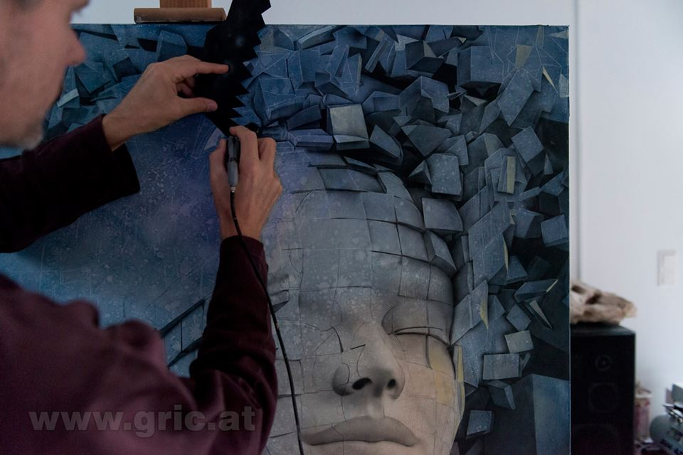
Biomechanical Art Examples
Peter Gric- Dissolution on Ego III 2014

Slide 4
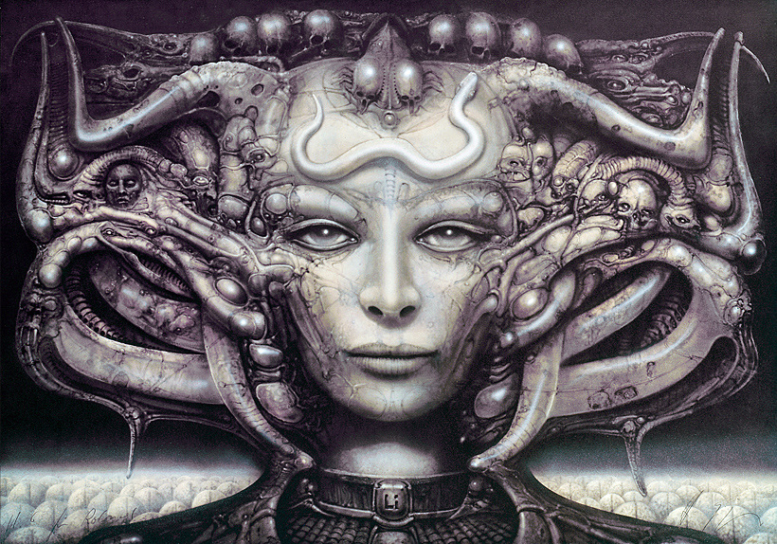
Biomechanical Art Examples
Best known for his visual effects in the “Alien”
films
H. R. Giger

Slide 5
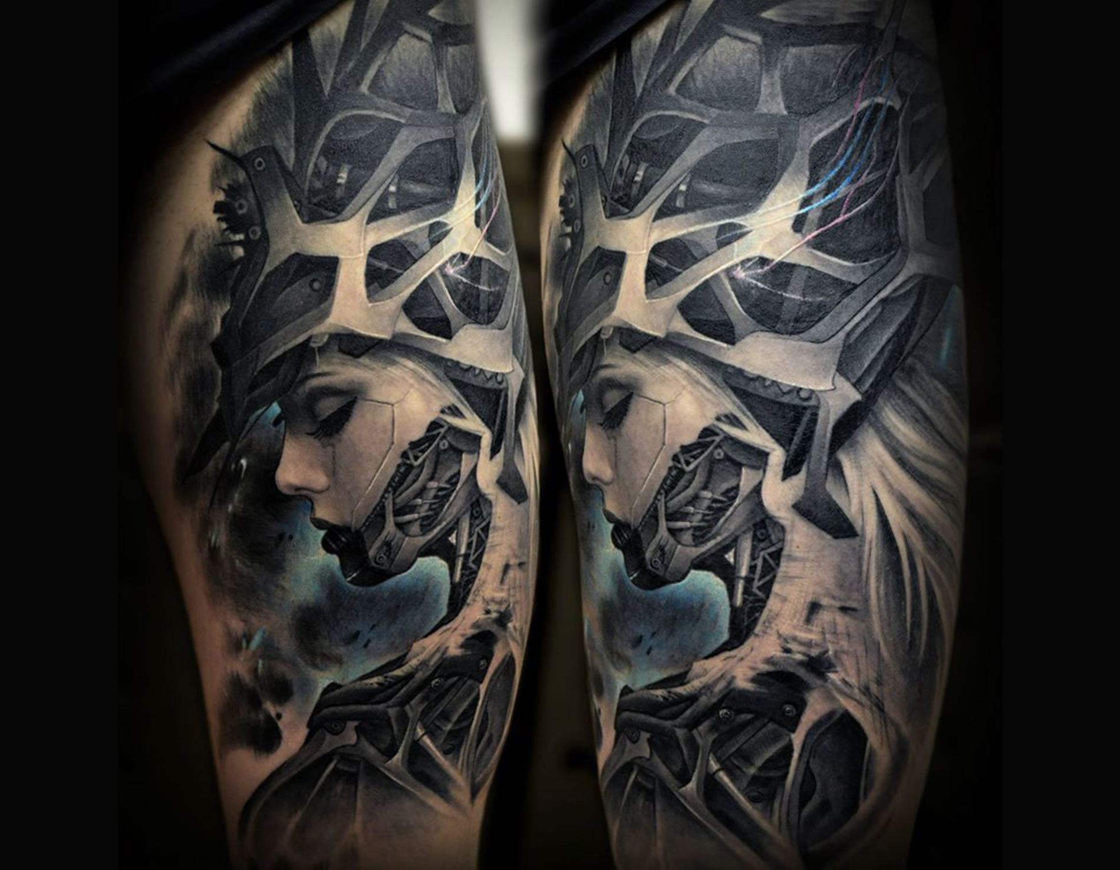
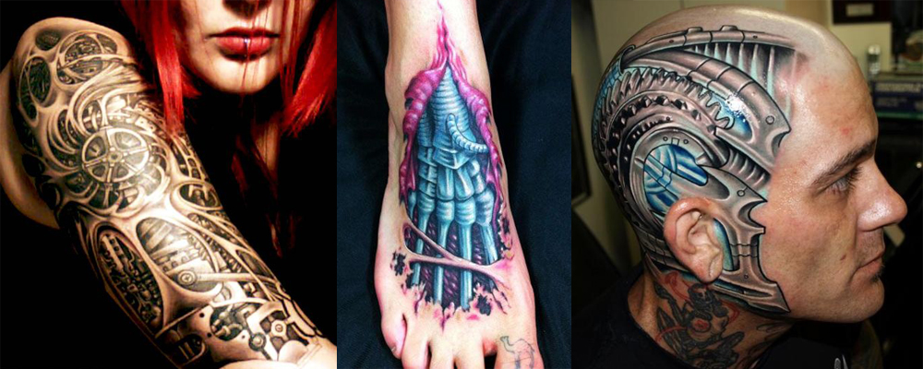
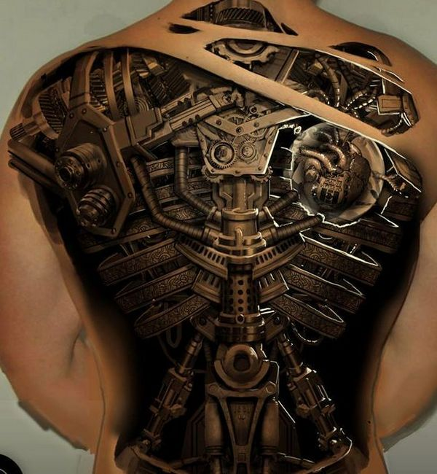
Biomechanical Art Examples
In tattoos

Slide 6
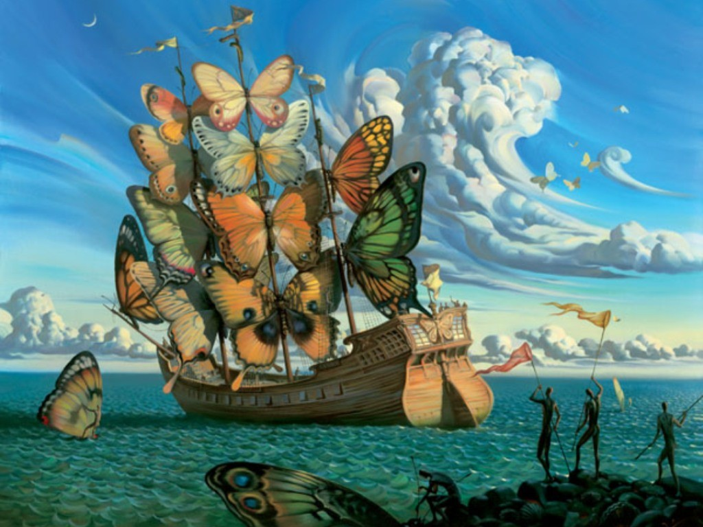
Surrealism- art movement that combines concepts of reality and the subconscious mind (dreams)
Overlay/Omit- Overlap both concepts & erase unnecessary lines
Vladimir Kush- Departure of the Winged Ship

Slide 7
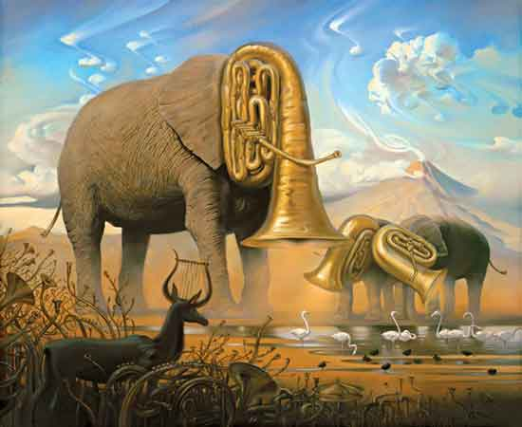
Overlay/Omit- Overlap both concepts and erase unnecessary lines
Vladimir Kush- African Sonata 1963

Slide 8
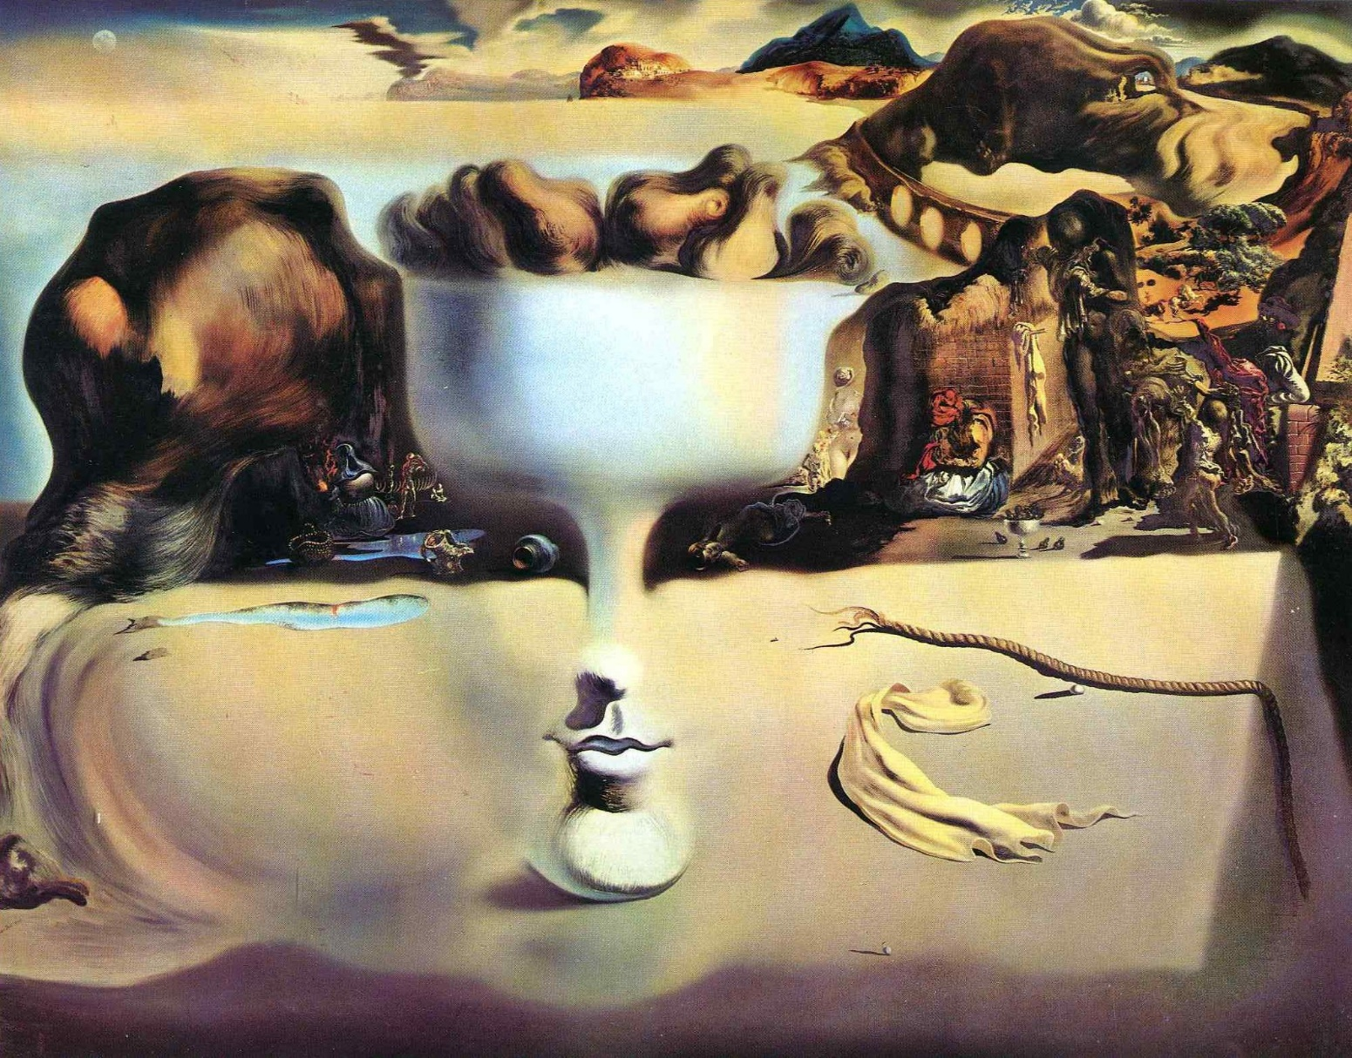
Morph/Distort- warp or skew both concepts to look more like a dream than reality
Salvador Dali- Apparition of Face and Fruit Dish on a Beach 1938

Slide 9
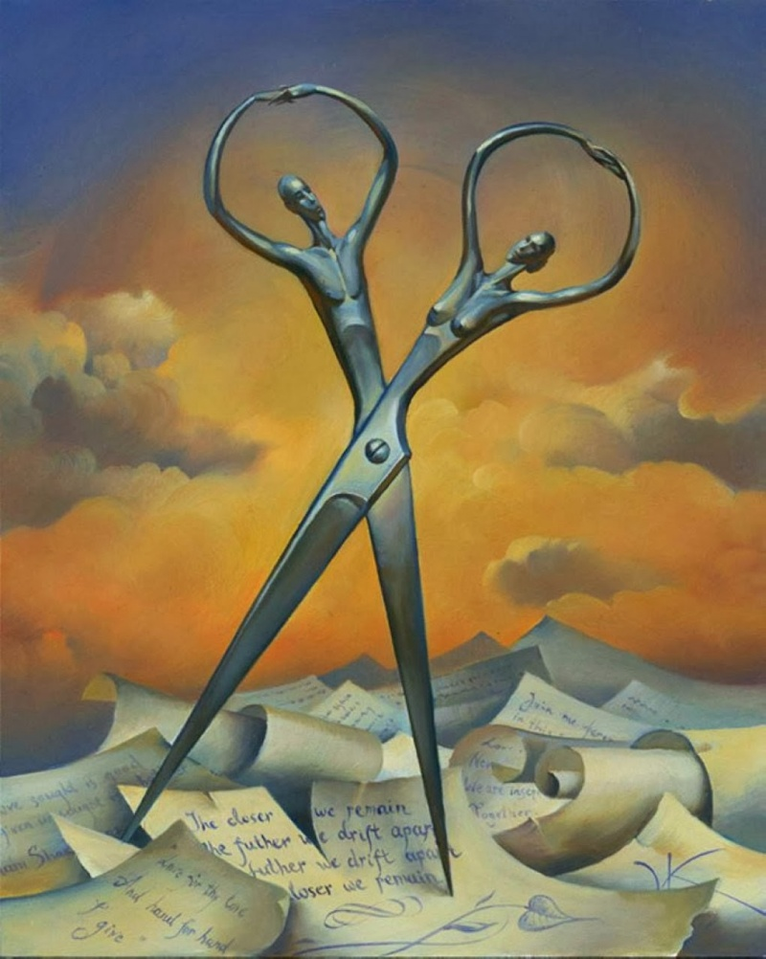
Transform- take two existing concepts and infuse them into one single form
Vladimir Kush- Always Together
Vladimir Kush- Always Together

Slide 10
Combining your Concepts
Morph/Distort- warp or skew both concepts to look more like a dream than reality
Transform- take two existing concepts and infuse them into one single form
Overlay/Omit- Overlap both concepts and erase unnecessary lines
Extend- Add one concept as an extension to another (i.e. a tree whose roots are wires and branches have robot elements)

Slide 11
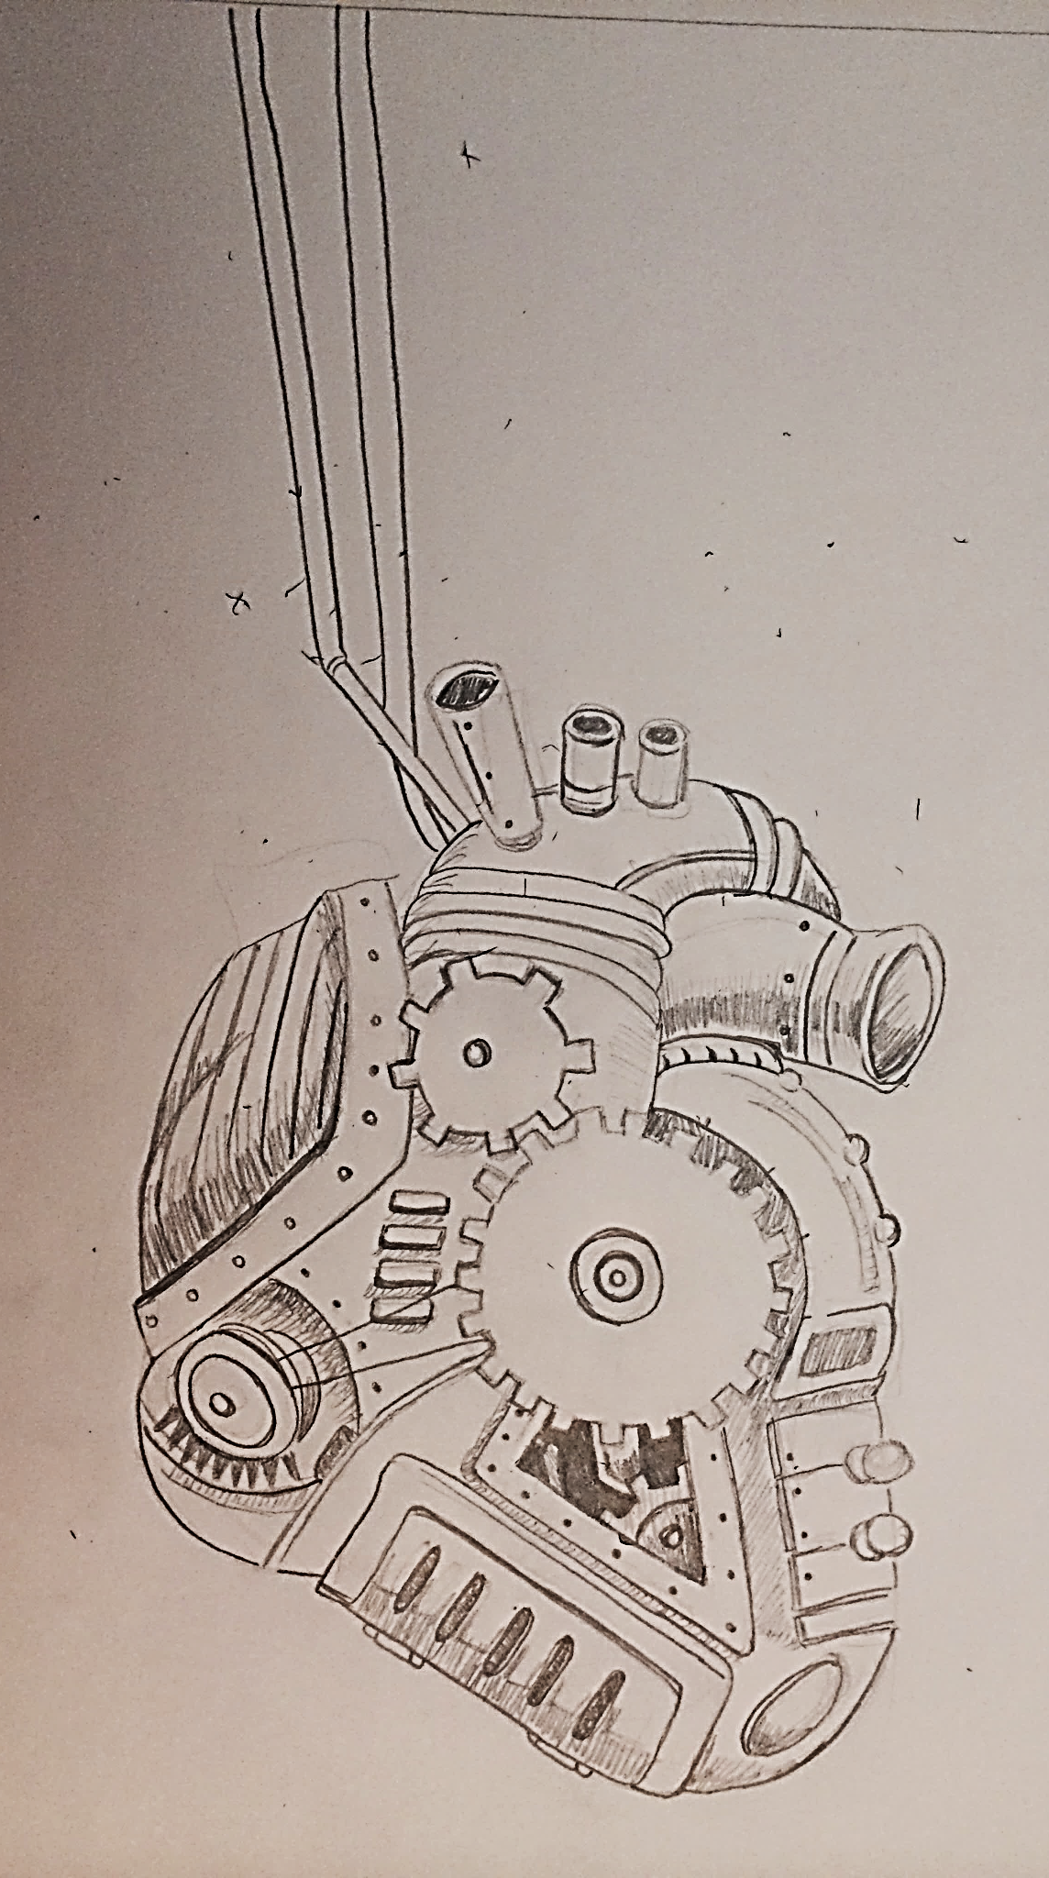
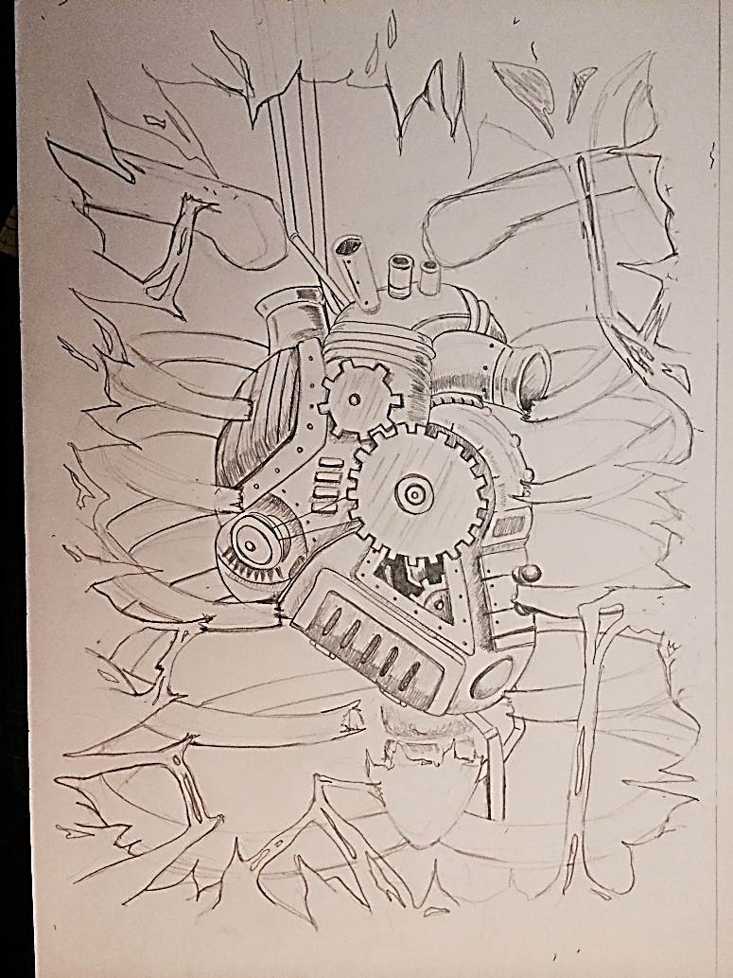
Steps 1 & 2
Establish drawings for both concepts
Determine how to connect them using techniques discussed in class

Slide 12
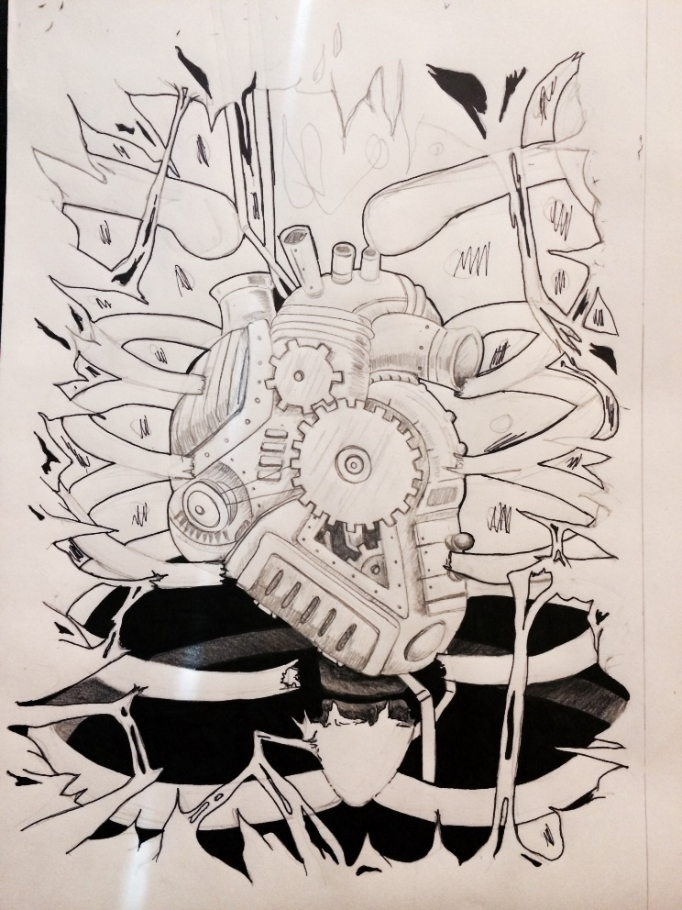
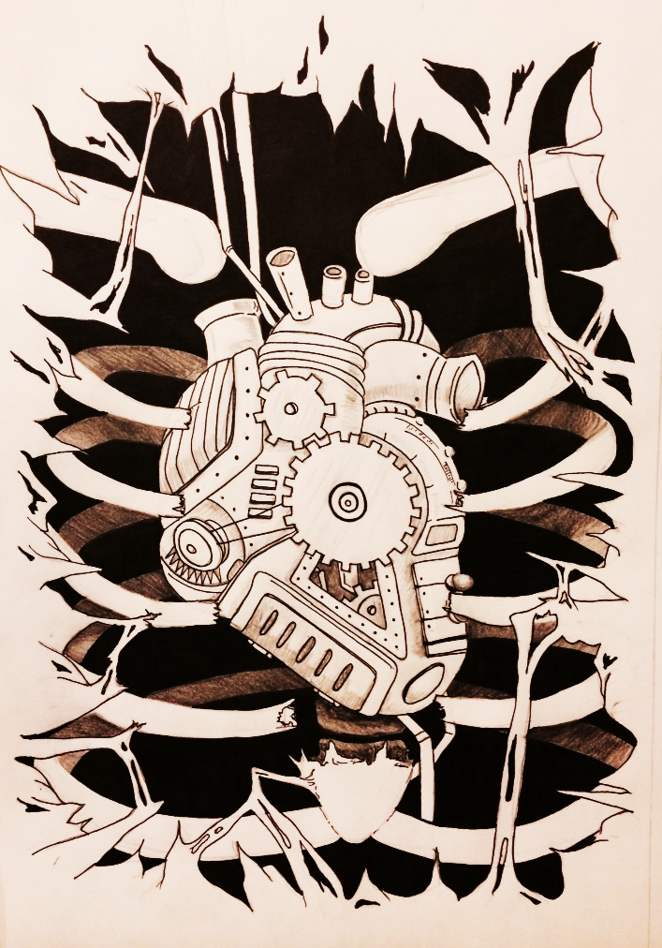
Start to develop composition by using the following techniques…
Fill in with permanent ink to create positive/negative space
Show texture by hatching, cross-hatching, stippling, etc.
You may also use graphite to establish value and form

Slide 13
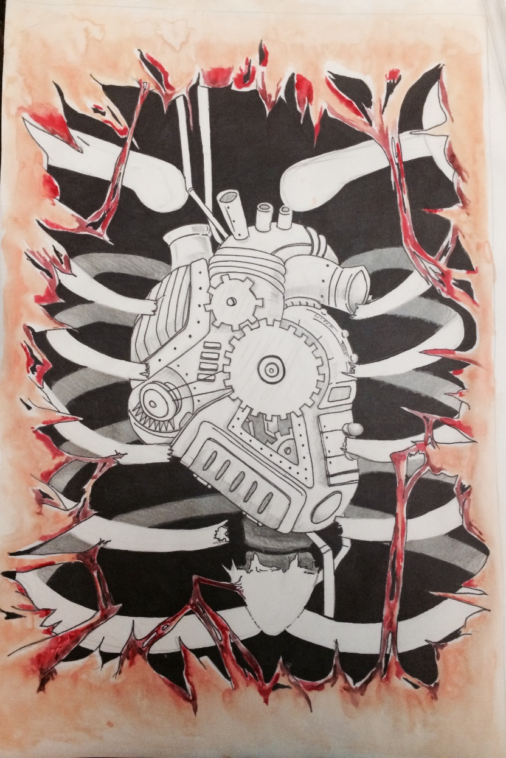
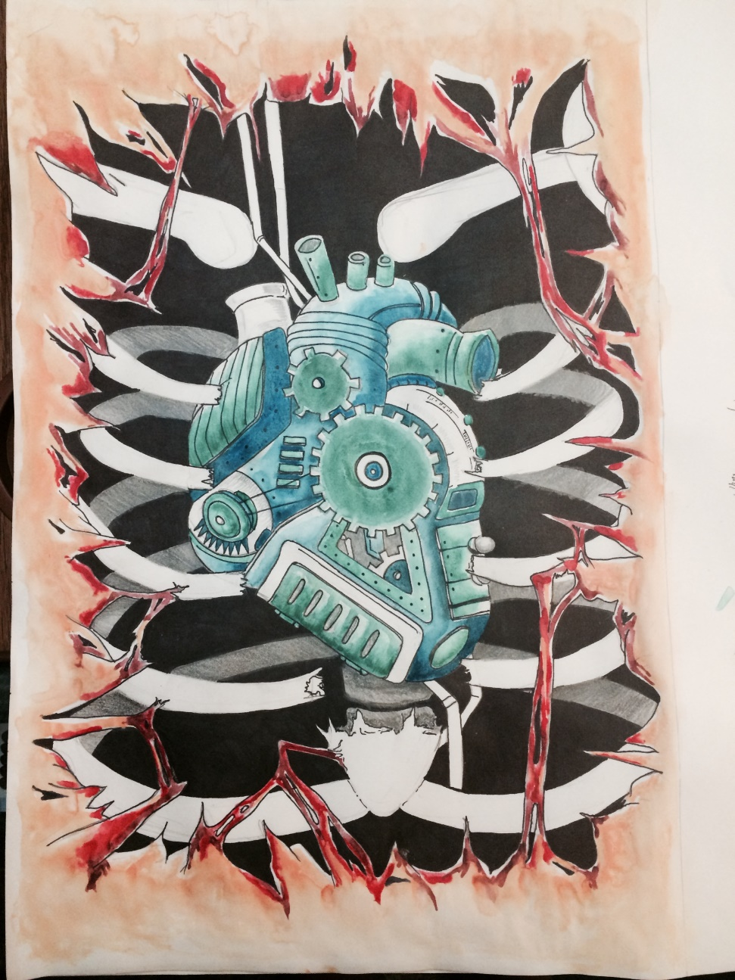
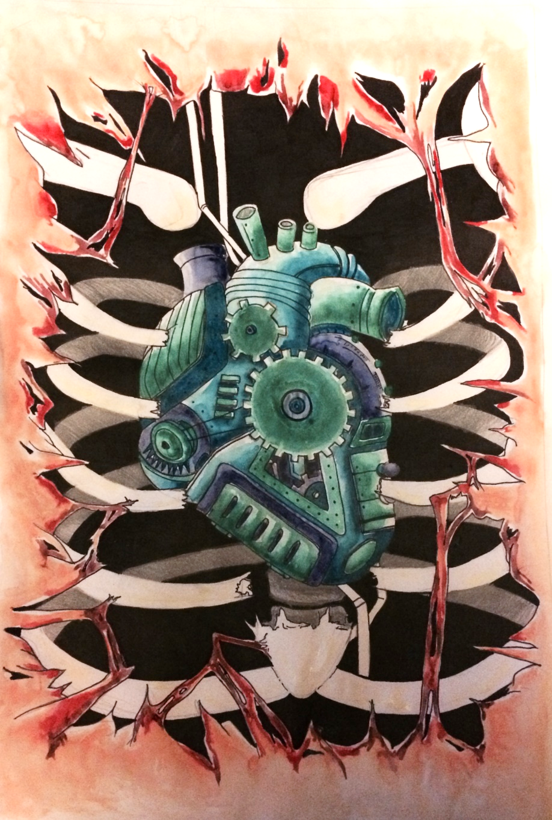
Additional Options- Adding small amounts of color to emphasize certain components

